Slide 1

Welcome Back
Lab 6-
Leveraging Existing Internet Tools to Promote your Website

Slide 2
Lab 6
Expectations
Chat Support Available During Webinars
Knowing Your Resources
Webinar Process
Facebook Support
Search: Crexendo UP Website Competition
Online Resources
up.Crexendo.com/unr

Slide 3
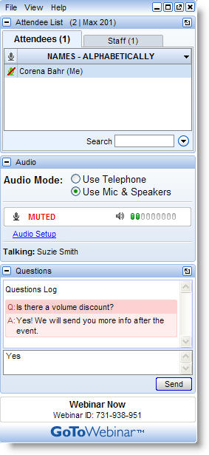
Lab 6
Live presentation
Attendees are muted
Type your questions in the “Questions” window
Questions answered live or via chat reply

Slide 4


Lab 6 Review
Webinar 5 Review
Live Directories
Free Live Directories
Paid Live Directories
Social Bookmarking
Adding products
Categorization
Taxes
Discounts
Ordering Rules
Publishing
Q&A

Slide 5

Lab 6
Webinar 5 Review
Live Directories
Free Live Directories
Paid Live Directories
Social Bookmarking
Q&A
Notes:
Web directories are large, topical, searchable directories that differ from traditional relevancy search engines in that their content is maintained by actual humans rather than by 'robot spyders' checking your site. Hence they are "live." Web directory personnel review your site and decide whether to include your website in their index. Sites in the index are located by browsing, by category, or by searching sites in the index using simple keyword matching. There are over a hundred Web directories on the Internet, each of varying importance. Nevertheless, your strategy should be to submit to all of them, if possible.

Slide 6
Lab 6
Webinar 5 Review
Live Directories
Free Live Directories
Paid Live Directories
Social Bookmarking
Free Live Directories List
DMOZ | Free | 8
MiriBlack | Free | 6
MasterMOZ Directory | Free&Paid | 6
Londovor | Free&Paid | 6
My Green Corner | Free&Paid | 6
The Shoppings | Free&Paid | 6
SEO Court | Free&Paid | 6
Can Links | Free | 5
Search Sight | Free | 5
Free Website Directory | Free&Paid | 5
eSearch Research | Free | 5
Prolink Directory | Free&Paid | 5
Ldmstudio Directory | Free | 5
Effective Project | Free | 5
Bee Directory | Free | 5
Q&A
Notes:
Web directories are large, topical, searchable directories that differ from traditional relevancy search engines in that their content is maintained by actual humans rather than by 'robot spyders' checking your site. Hence they are "live." Web directory personnel review your site and decide whether to include your website in their index. Sites in the index are located by browsing, by category, or by searching sites in the index using simple keyword matching. There are over a hundred Web directories on the Internet, each of varying importance. Nevertheless, your strategy should be to submit to all of them, if possible.

Slide 7
Lab 6
Webinar 5 Review
Live Directories
Free Live Directories
Paid Live Directories
Social Bookmarking
Paid Live Directories List
Yahoo! Directory | Paid | 8
Family Friendly Sites | Paid | 7
Most Popular Sites | Paid | 6
Ezilon Directory | Paid | 6
GreenStalk Directory | Paid | 6
Niche-Listings.com | Paid | 6
MasterMOZ Directory | Free&Paid | 6
Londovor | Free&Paid | 6
My Green Corner | Free&Paid | 6
Lola Directory | Paid | 6
The Shoppings | Free&Paid | 6
Linksgiving.com | Paid | 6
SEO Court | Free&Paid | 6
BOTW | Paid | 6
InCrawler Web Directory | Paid | 6
AllTaste Directory | Paid | 6
Kahuki Directory | Paid | 6
RakCha | Paid | 6
Directory Journal | Paid | 6
World Links Directory | Paid | 6
Top Web Directory | Paid | 6
Quality Web Directory | Paid | 6
8jj directory | Recip&Paid | 6
SplashDirectory | Paid | 6
Q&A
Notes:
Web directories are large, topical, searchable directories that differ from traditional relevancy search engines in that their content is maintained by actual humans rather than by 'robot spyders' checking your site. Hence they are "live." Web directory personnel review your site and decide whether to include your website in their index. Sites in the index are located by browsing, by category, or by searching sites in the index using simple keyword matching. There are over a hundred Web directories on the Internet, each of varying importance. Nevertheless, your strategy should be to submit to all of them, if possible.

Slide 8

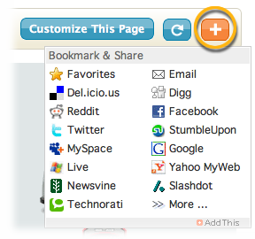
Lab 6
Webinar 5 Review
Live Directories
Free Live Directories
Paid Live Directories
Social Bookmarking
Social Bookmarking
Q&A
Notes:
1. Existing Knowledge
2. Facebook
3. Twitter
4. Stumble-upon
5. Digg
6. Google+

Slide 9

Lab 5
Webinar 5 Review
Live Directories
Free Live Directories
Paid Live Directories
Social Bookmarking
Questions
Answers
Q&A

